Slide 1
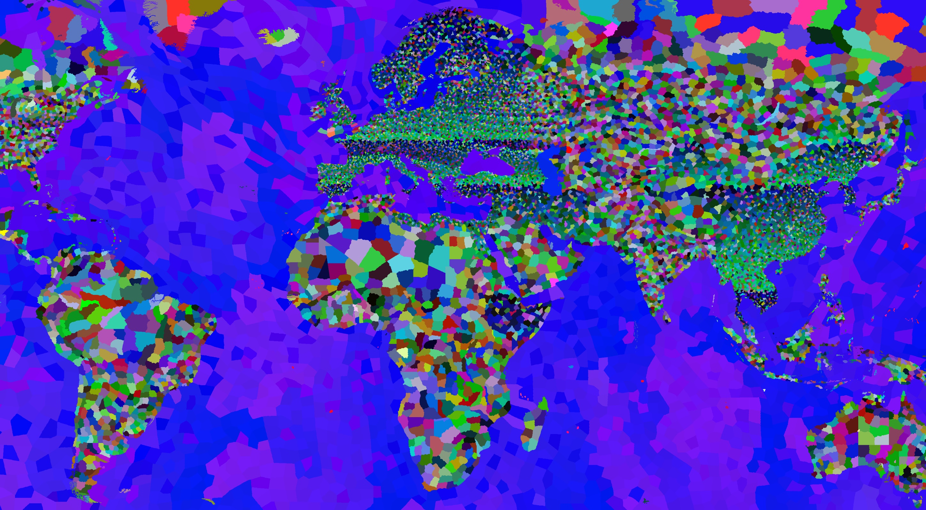
EOE’s
MAP MOD
19347
150% MORE
PROVINCES
EUROPA
CHINA
MIDDLE EAST
NORTH AFRICA
SE-ASIA
HORN OF AFRICA

Slide 2
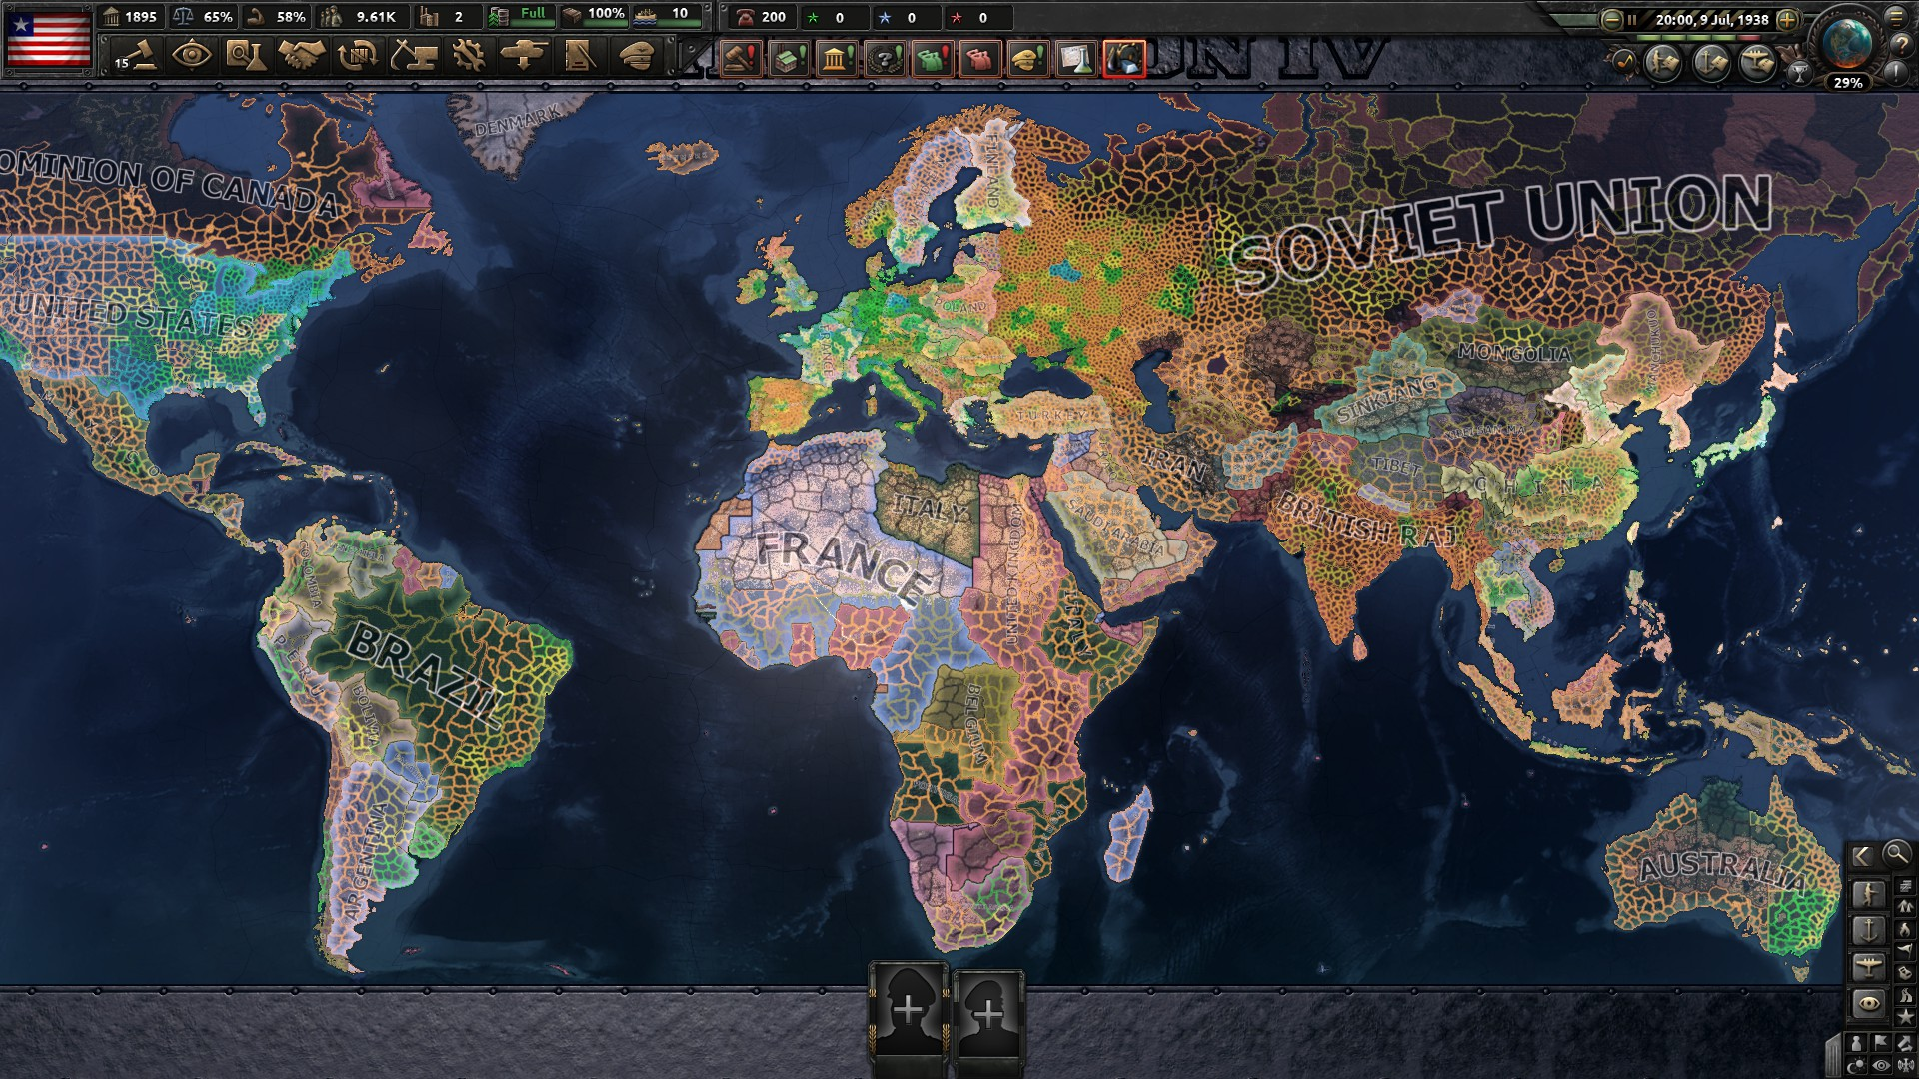
EOE’s
MAP MOD
10086
1200% MORE
STATES

Slide 3
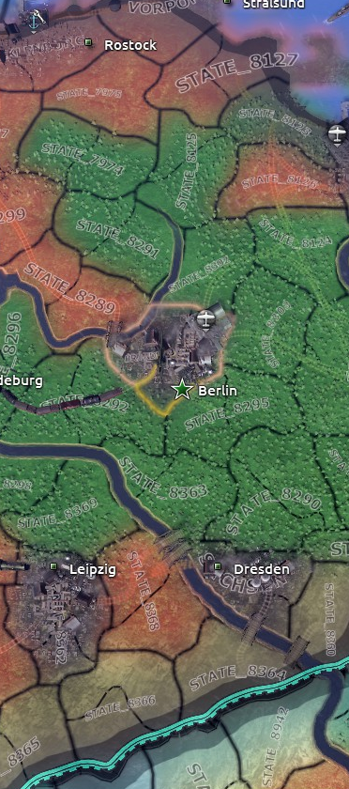
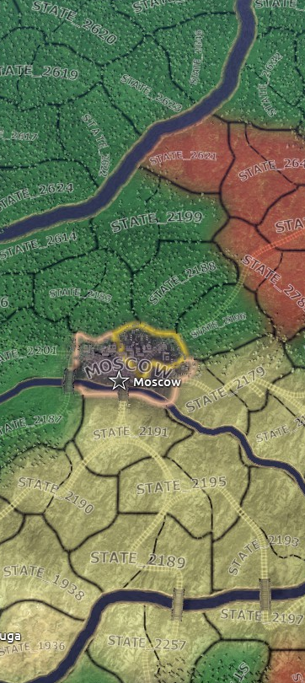
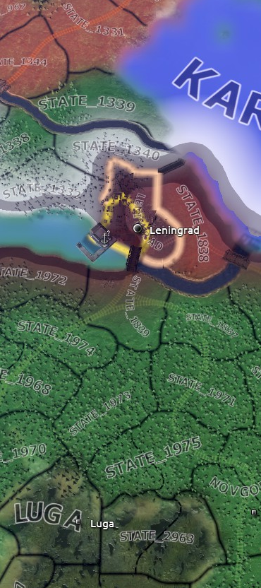
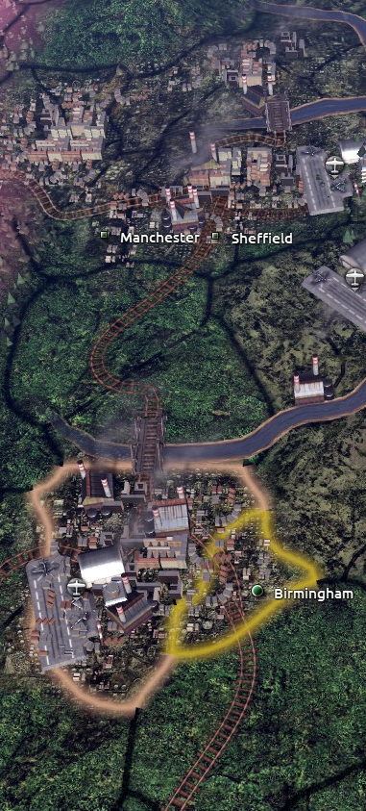
EOE’s
MAP MOD
MORE TILES
FOR URBANS

Slide 4
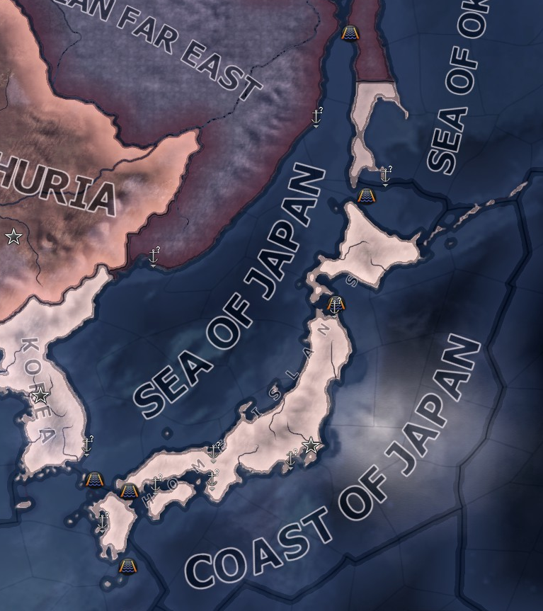
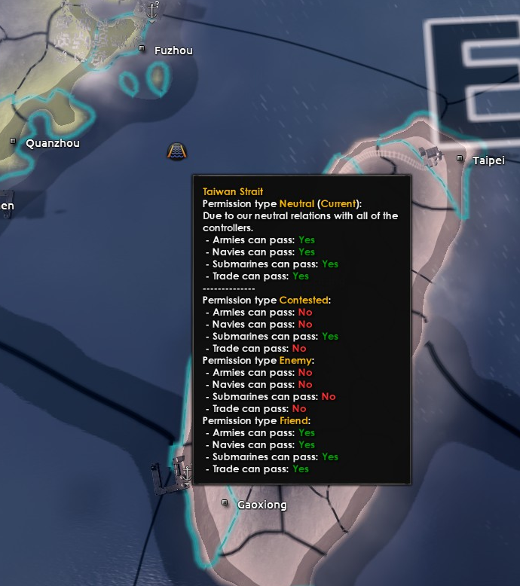
EOE’s
MAP MOD
MORE STRAITS
Tartary Strait
Sōya Strait
TRUE SEA OF JAPAN
Stugaru Strait
Korea Strait
Kanmon Strait
Ōsumi Strait

Slide 5
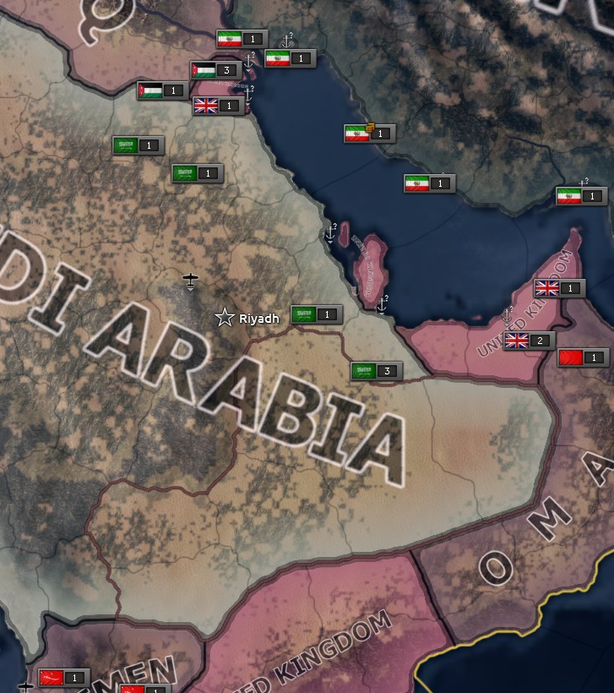
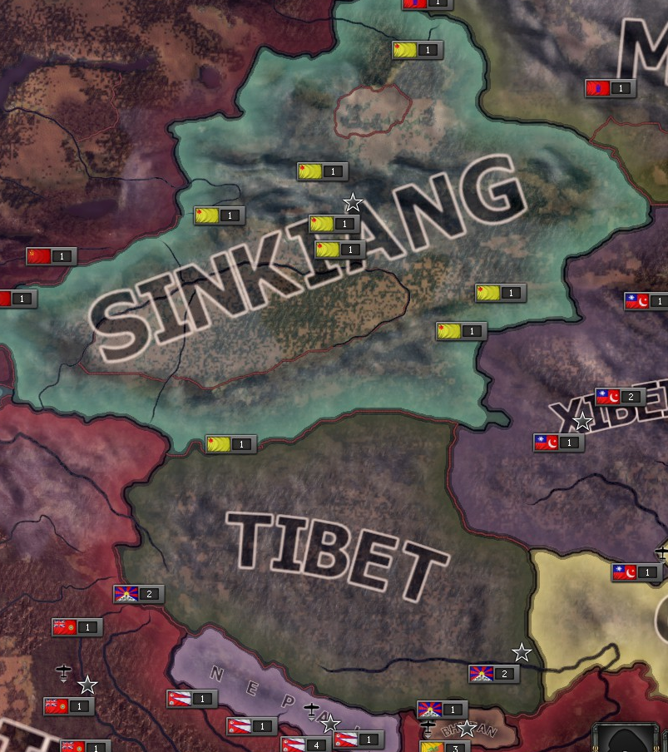
EOE’s
MAP MOD
MORE IMPASSABLE MOUNTAINS/DESERTS

Slide 6
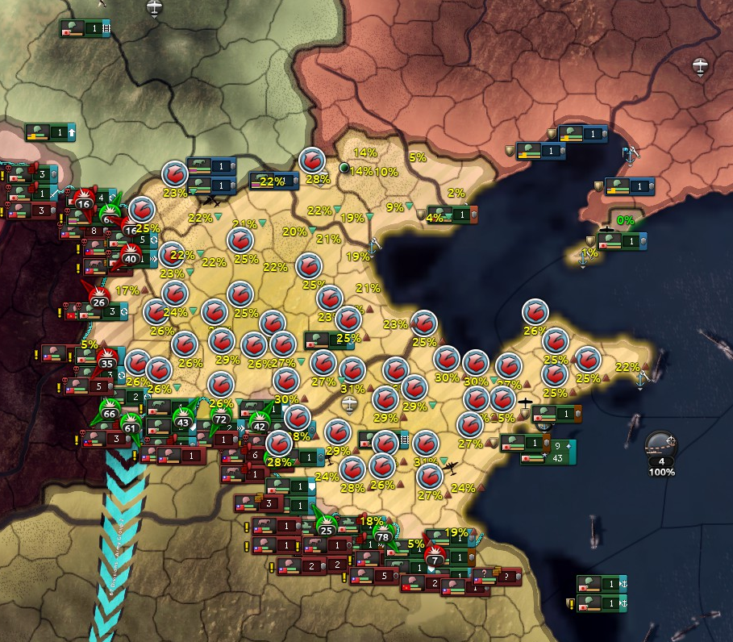
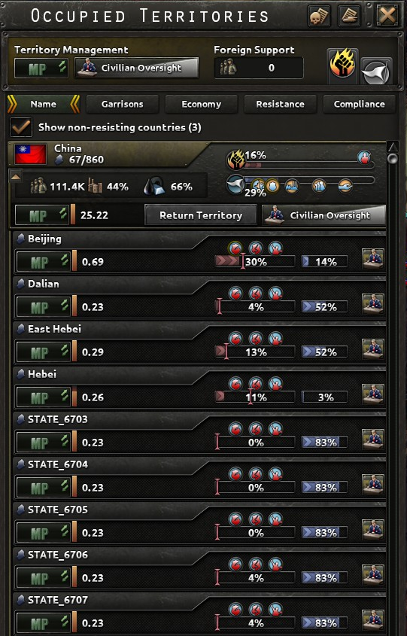
EOE’s
MAP MOD
NEW
SUPPRESSION UNIT

Slide 7
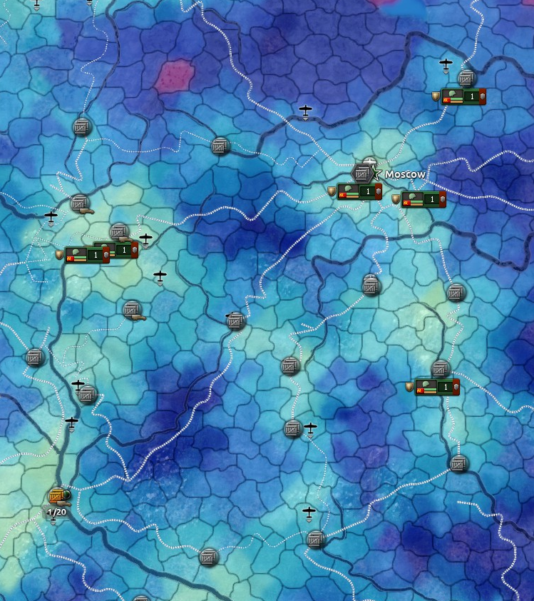
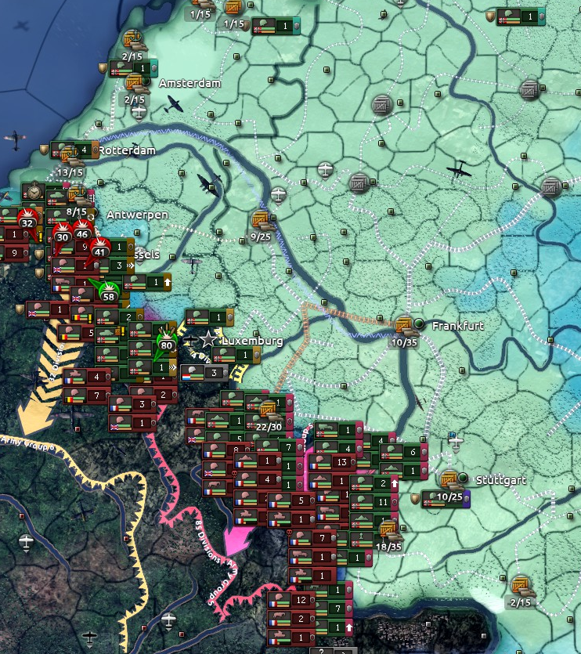
EOE’s
MAP MOD
RAILWAY

Slide 8
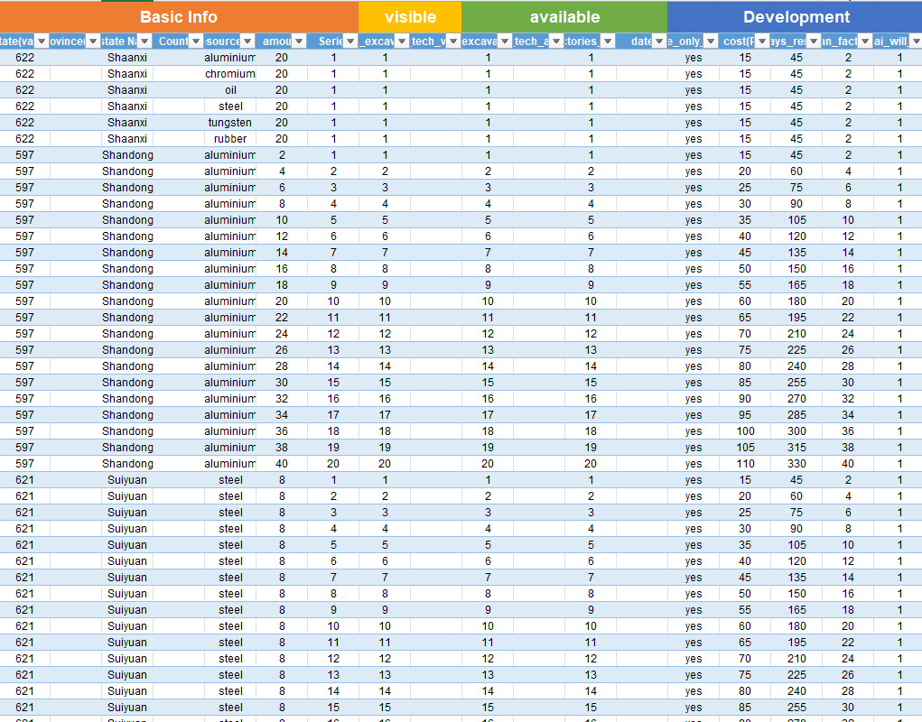
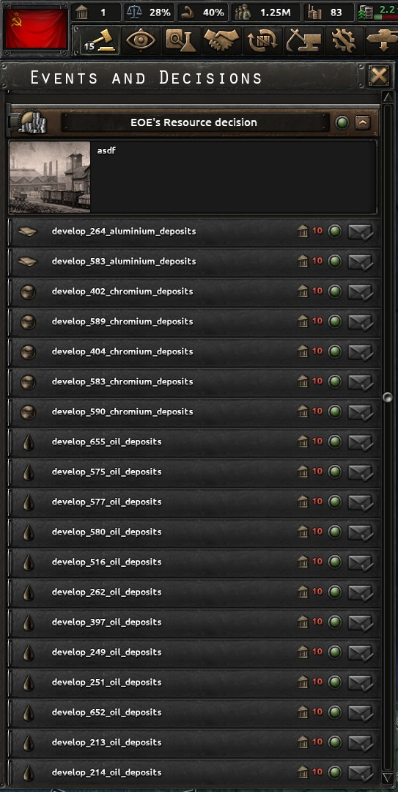
EOE’s
MAP MOD
MINING RESOURCES
(BETA)

